Slide 1
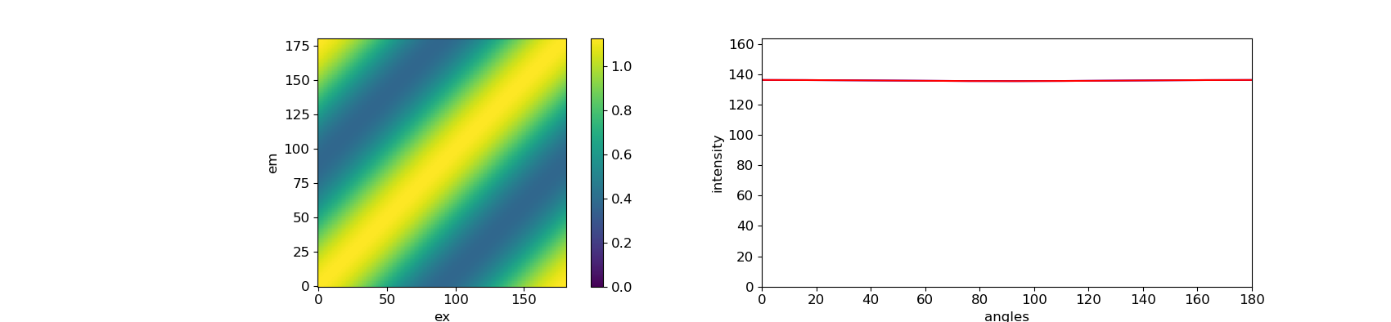
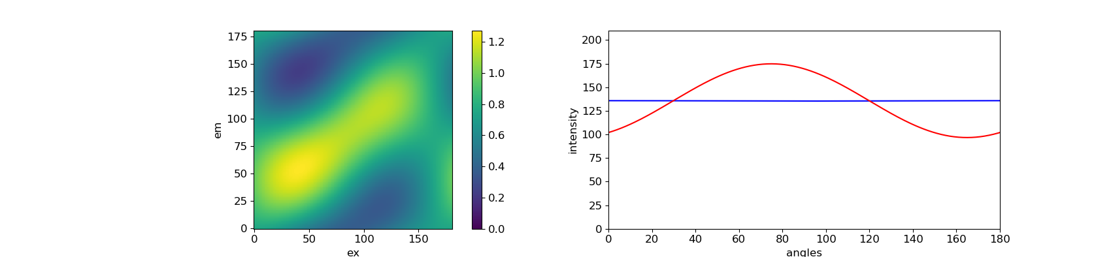
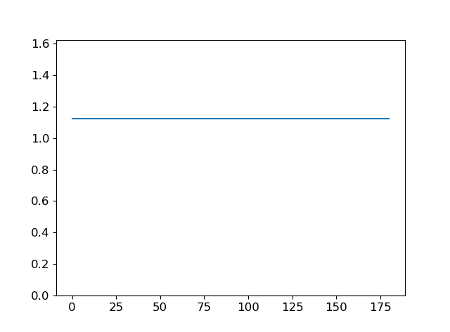
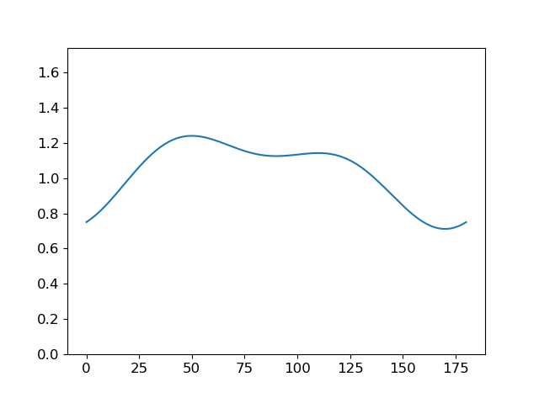
theta = [0, 60, 120]
et_matrix = ([1.0, 0.0, 0.0],
[0.0, 1.0, 0.0],
[0.0, 0.0, 1.0])
theta = [0, 60, 120]
et_matrix = ([0.5, 0.5, 0.0],
[0.0, 1.0, 0.0],
[0.0, 0.0, 1.0])

Slide 2
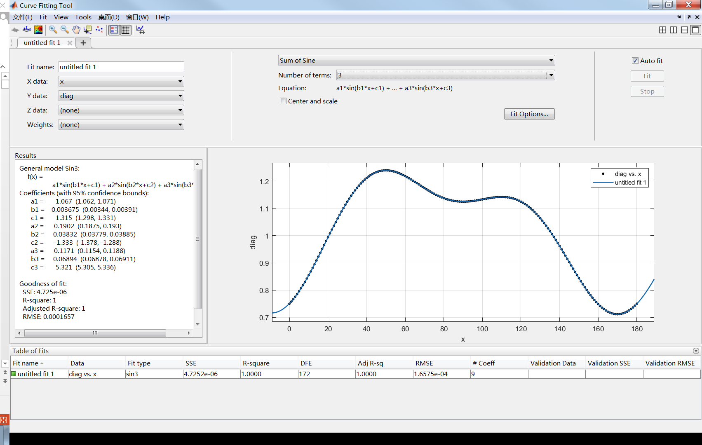

Slide 3
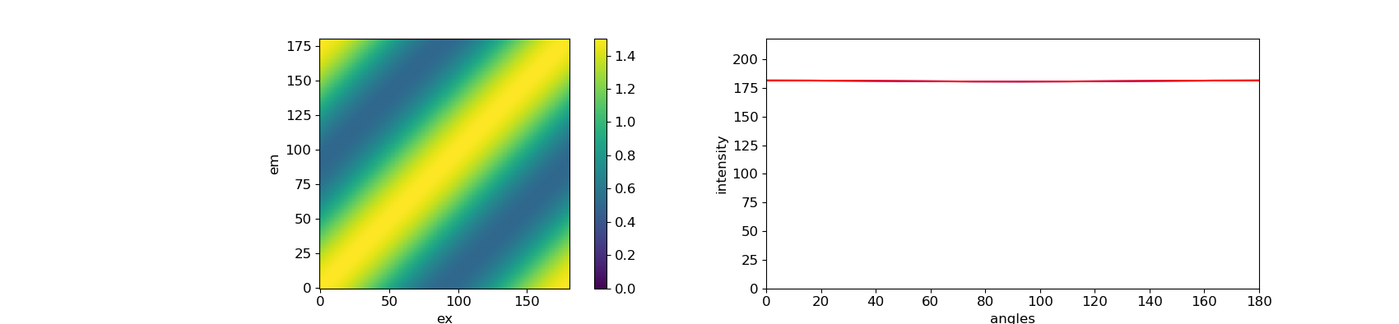
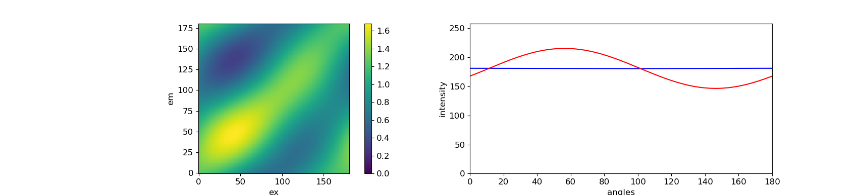
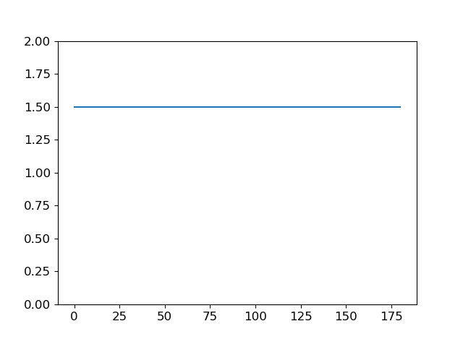
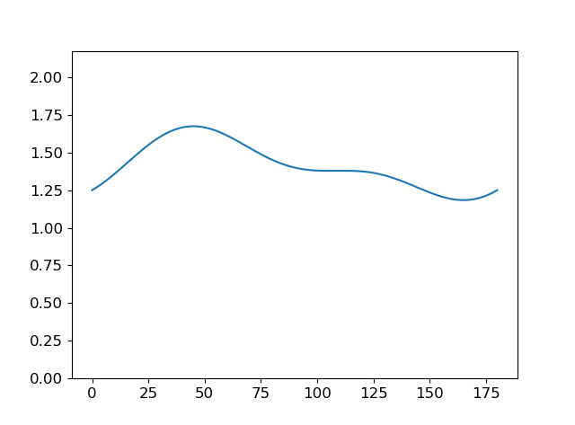
theta = [0, 45, 90, 135]
et_matrix = ([0.5, 0.5, 0.0, 0.0],
[0.0, 1.0, 0.0, 0.0],
[0.0, 0.2, 0.8, 0.0],
[0.0, 0.0, 0.0, 1.0])

Slide 4
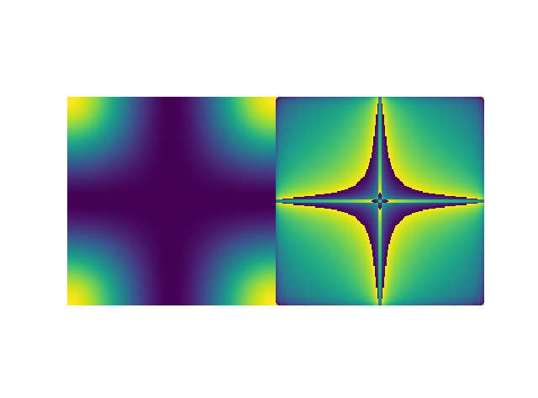
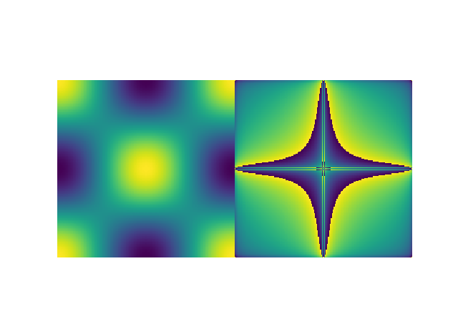
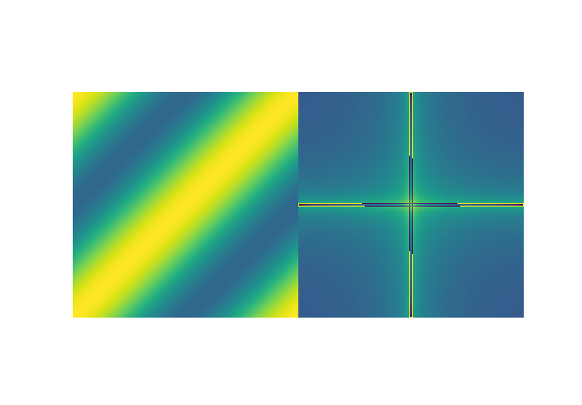
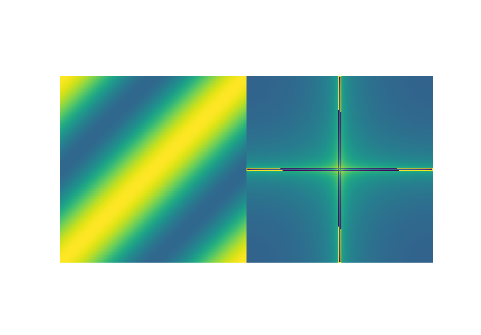


0
0, 90
0, 60, 120
0, 45, 90, 135
0, 36, 72, 108, 144
0, 30, 60, 90, 120, 150

Slide 6
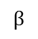
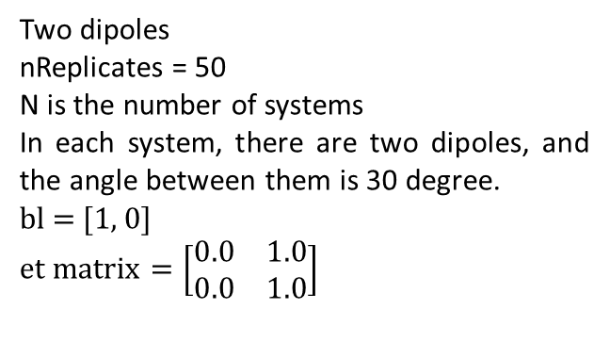
Two dipoles
nReplicates = 50
N is the number of systems
In each system, there are two dipoles, and the angle between them is 30 degree.
bl = [1, 0]
$$et matrix=\left[\begin{matrix}0.0 & 1.0 \\ 0.0 & 1.0\end{matrix}\right]$$
100%
$$β$$
A molecule have independent polarized absorber (M = 1) and emitter (M = 1). 100% energy transfer from absorber to emitter.
N = 1
N = 2
N = 4

Slide 7
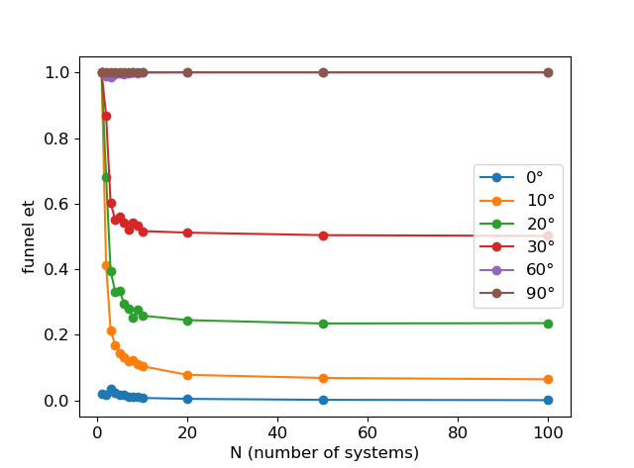
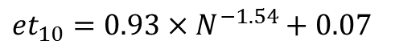
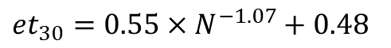
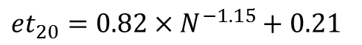
Plot N – et for different angle between two dipoles
Fitting of 40 degree is not good
${et}_{30}=0.55×N^{−1.07}+0.48$
${et}_{20}=0.82×N^{−1.15}+0.21$
${et}_{10}=0.93×N^{−1.54}+0.07$

Slide 8
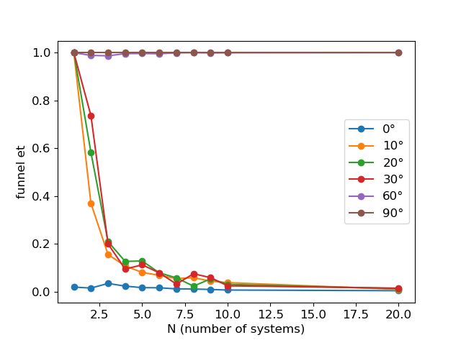

Slide 9
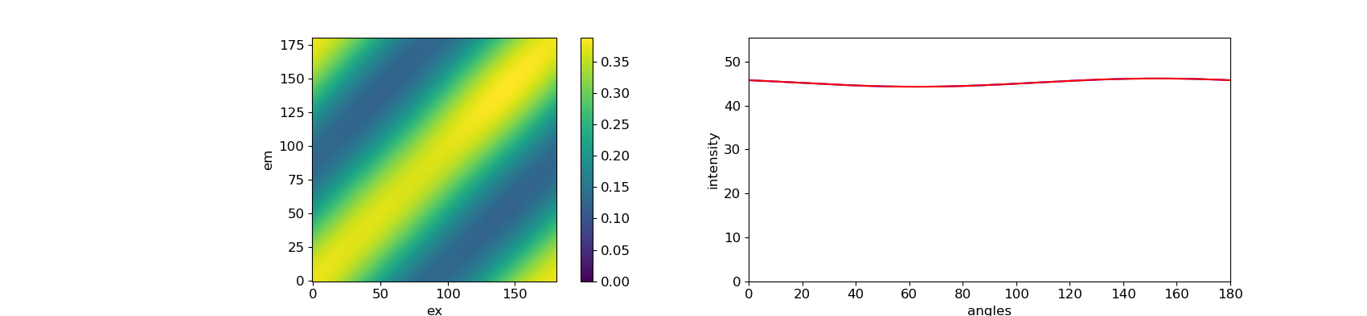
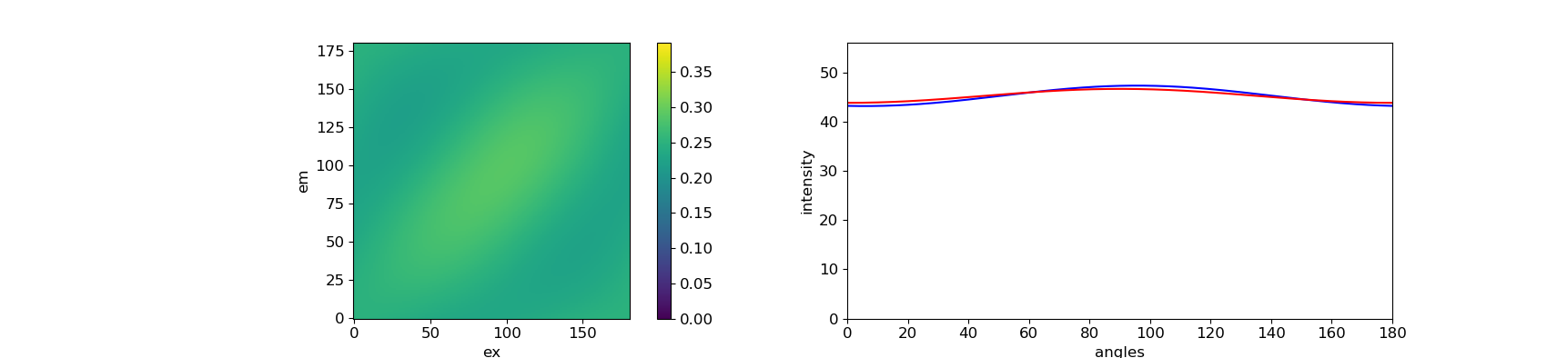
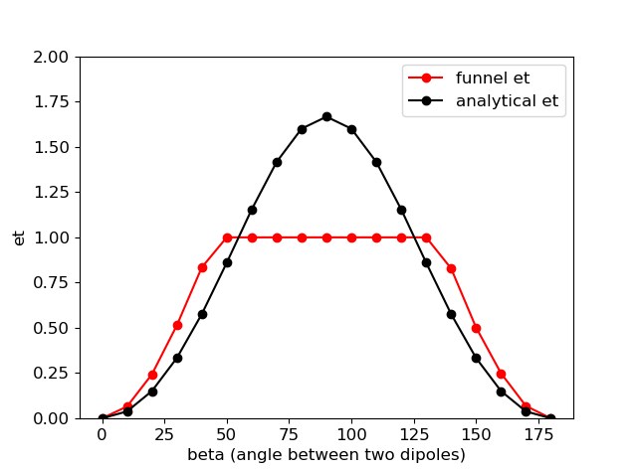
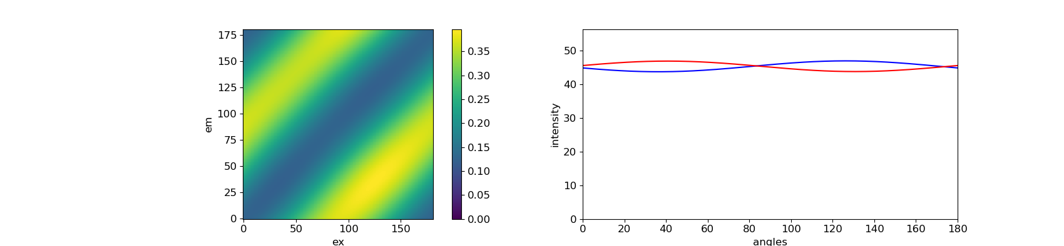
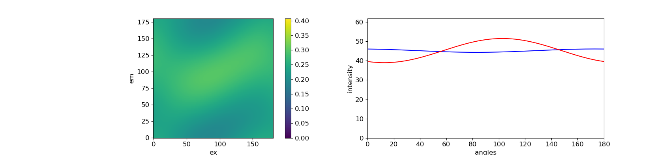
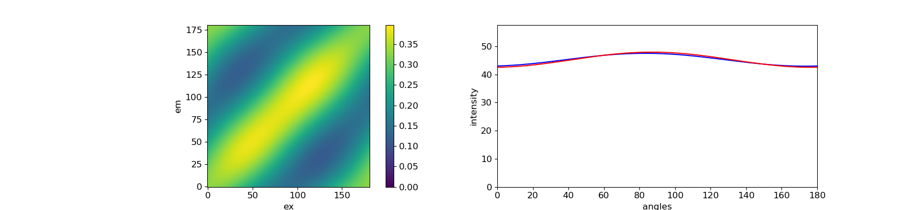
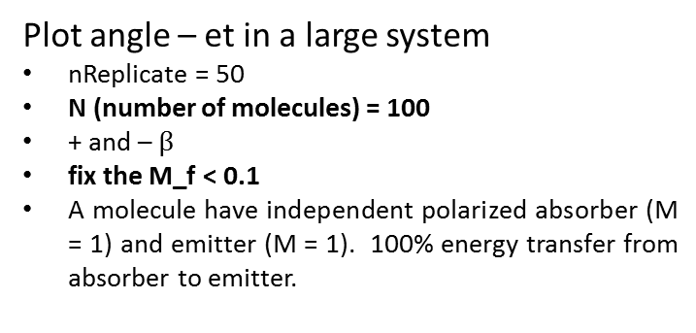
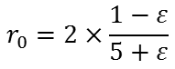
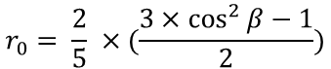
Funnel et
Plot angle – et in a large system
nReplicate = 50
N (number of molecules) = 100
+ and – $β$
fix the M_f < 0.1
A molecule have independent polarized absorber (M = 1) and emitter (M = 1). 100% energy transfer from absorber to emitter.
100%
0°
β | et | residue
0° | 0 | 0.004
10° | 0.065 | 0.005
20° | 0.243 | 0.007
30° | 0.514 | 0.007
40° | 0.834 | 0.006
50° | 1 | 0.016
60° | 1 | 0.037
70° | 1 | 0.056
80° | 1 | 0.069
90° | 1 | 0.074
100° | 1 | 0.069
110° | 1 | 0.056
120° | 1 | 0.036
130° | 1 | 0.014
140° | 0.828 | 0.005
150° | 0.502 | 0.006
160° | 0.249 | 0.007
170° | 0.068 | 0.007
180° | 0 | 0.004
$$β$$
40°
90°
140°
analytical et
$$r_{0}= \frac{2}{5} ×(\frac{3×\cos^{2}{β}−1}{2})$$
$$r_{0}=2×\frac{1−ε}{5+ε}$$
Can we use this eq. here? The situation is sligtly different
170°

Slide 10
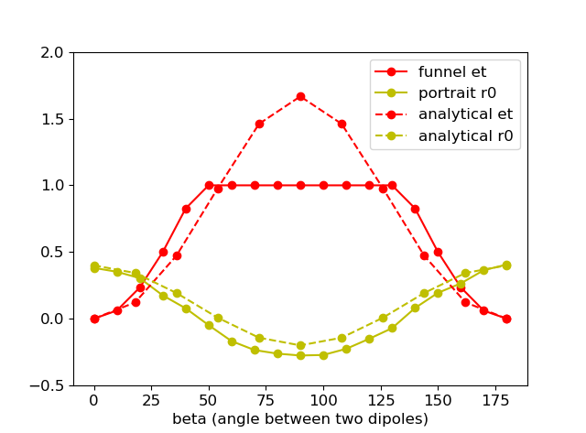
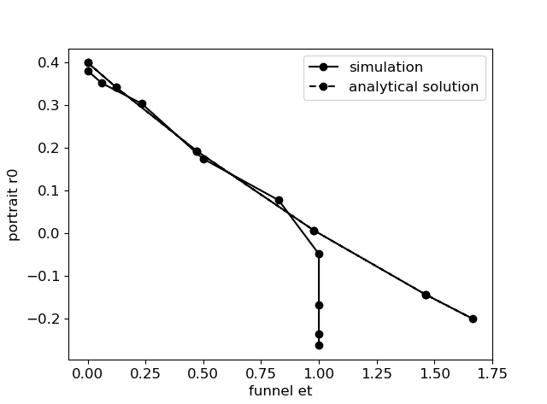
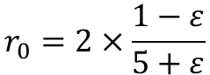
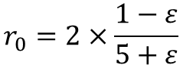
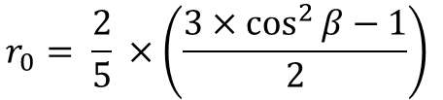
Two dipoles
$$r_{0}= \frac{2}{5} ×\left(\frac{3×\cos^{2}{β}−1}{2}\right)$$
$$r_{0}=2×\frac{1−ε}{5+ε}$$
Work for 3D
$$r_{0}=2×\frac{1−ε}{5+ε}$$

Slide 11
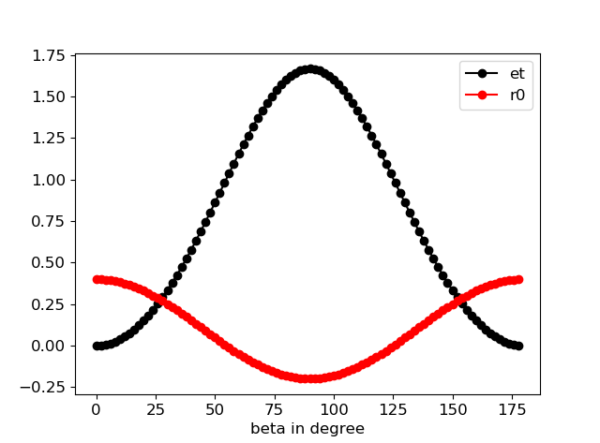
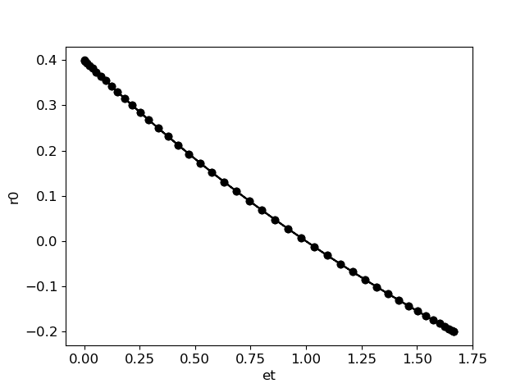
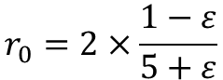
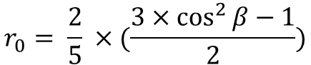
$$r_{0}= \frac{2}{5} ×(\frac{3×\cos^{2}{β}−1}{2})$$
$$r_{0}=2×\frac{1−ε}{5+ε}$$

Slide 12
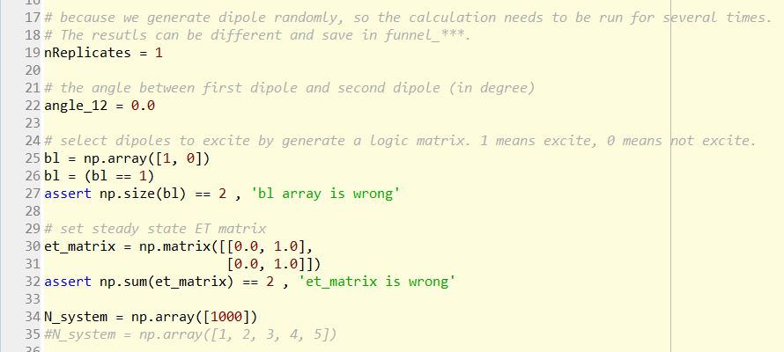
Anisotropy

Slide 13
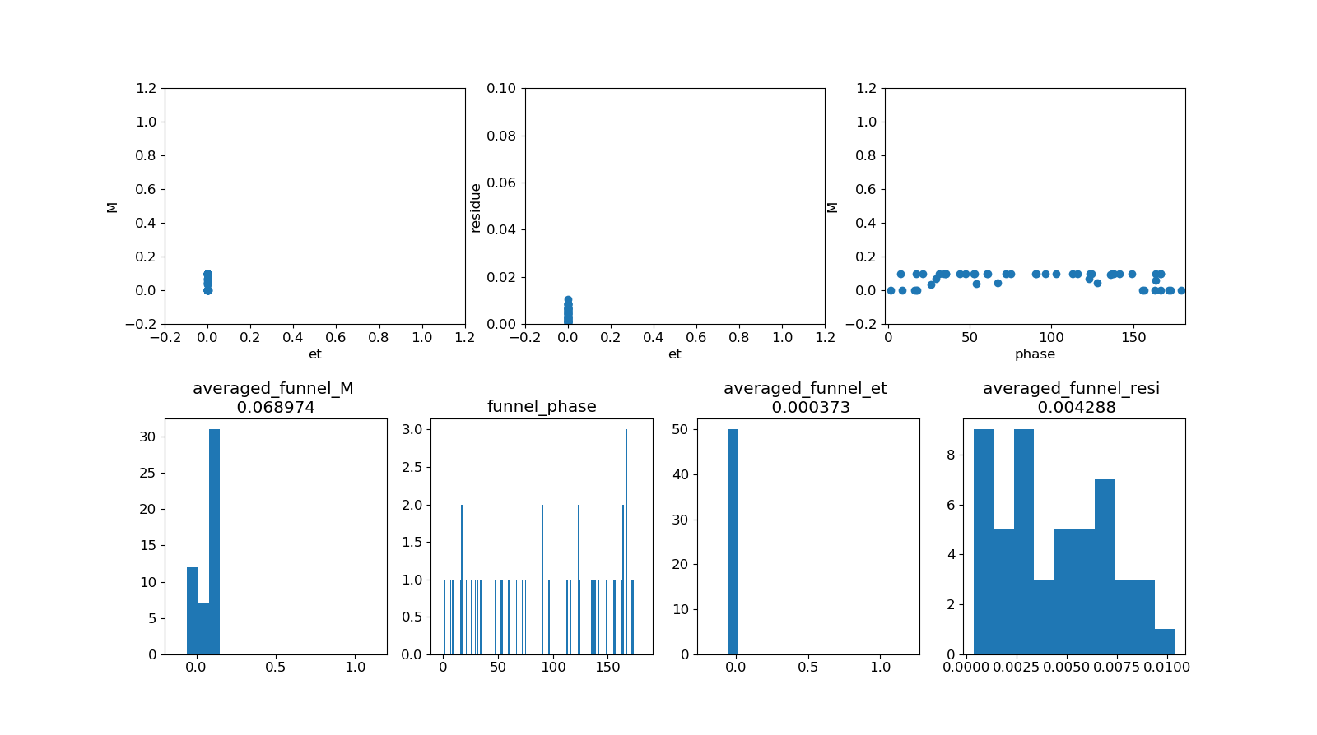
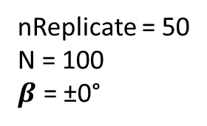
nReplicate = 50
N = 100
$β$ = ±0°

Slide 14
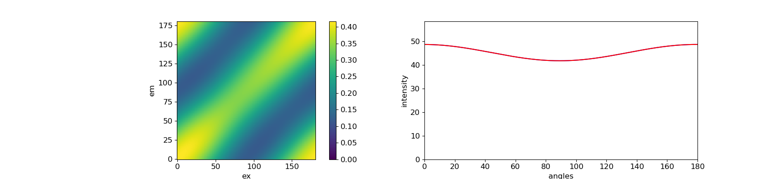
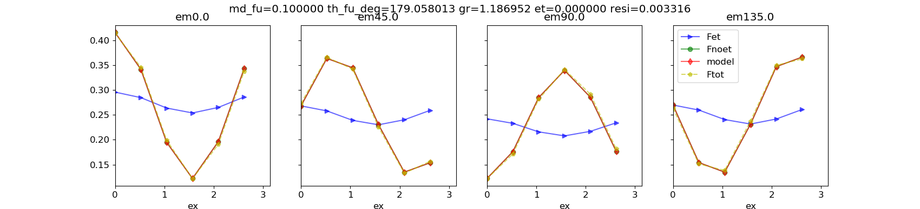
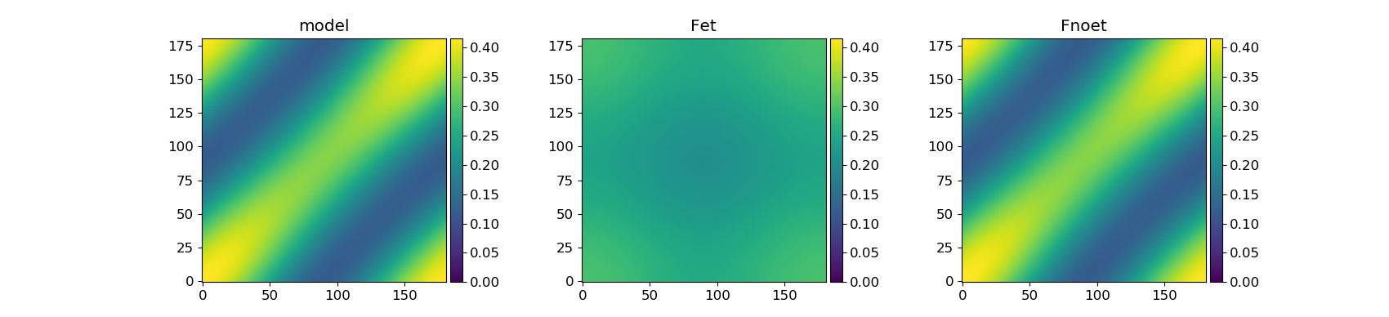
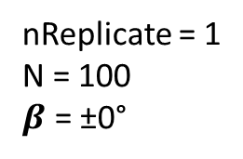
nReplicate = 1
N = 100
$β$ = ±0°

Slide 15
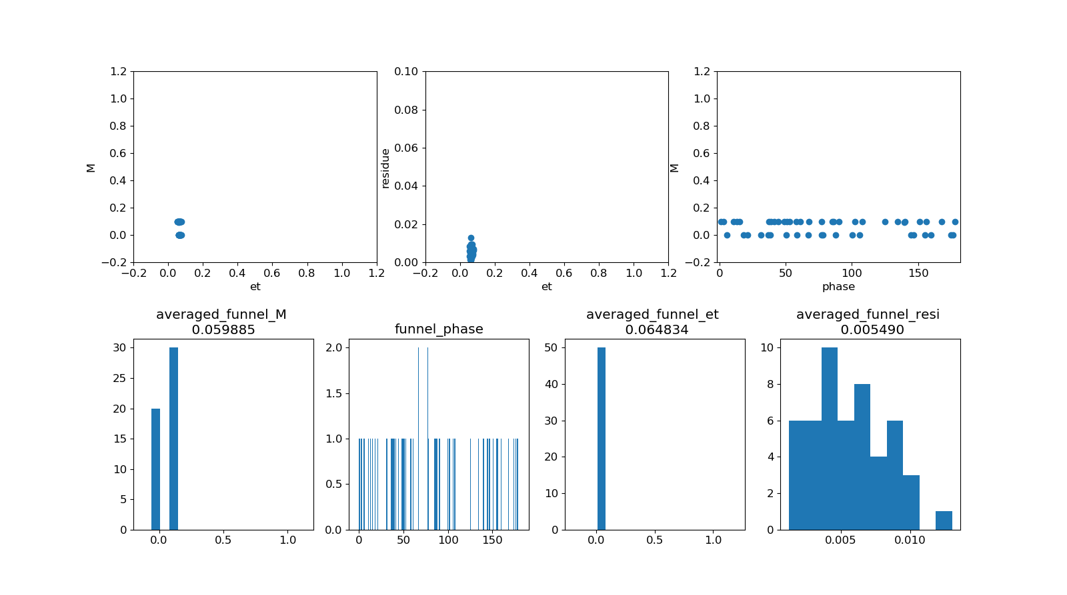
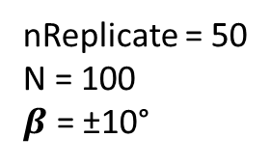
nReplicate = 50
N = 100
$β$ = ±10°

Slide 16
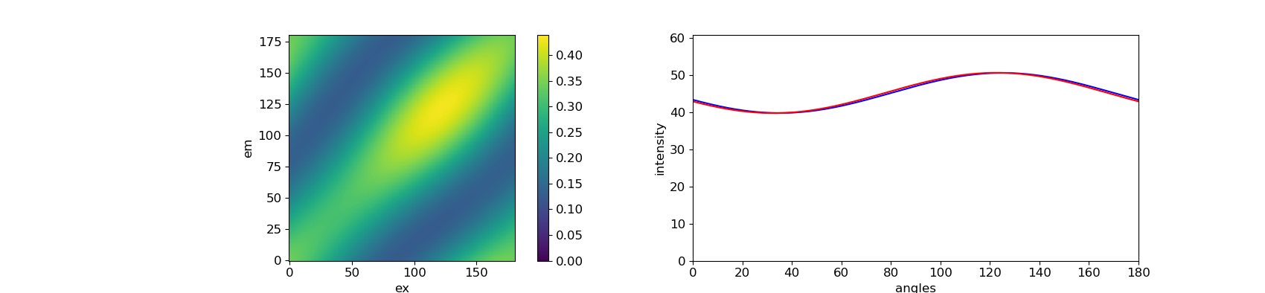
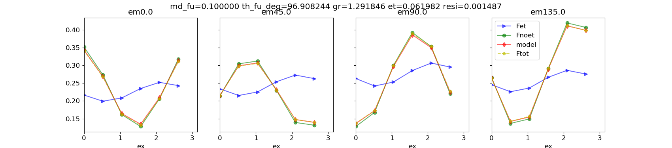
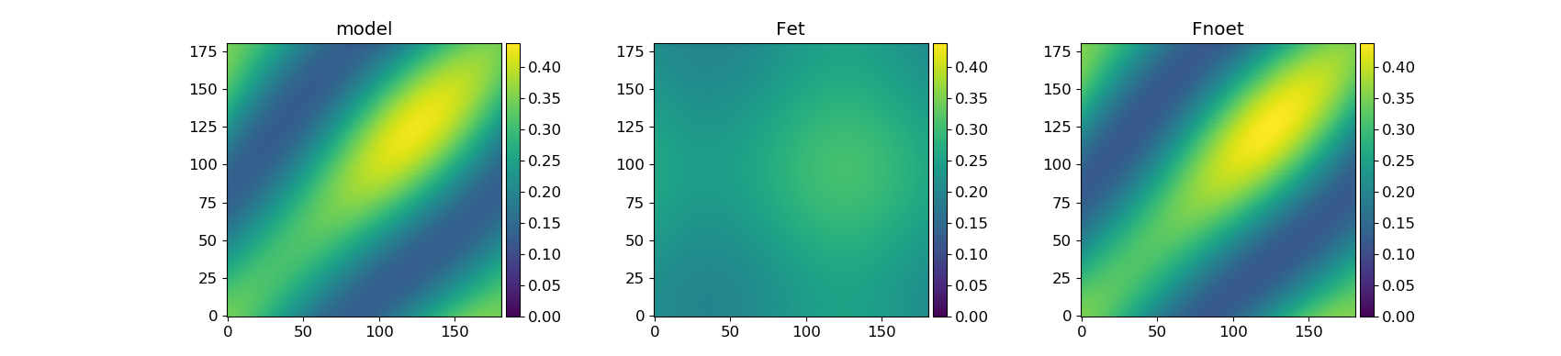
nReplicate = 50
N = 100
$β$ = ±10°

Slide 17


nReplicate = 50
N = 100
$β$ = ±20°

Slide 18




nReplicate = 1
N = 100
$β$ = ±20°

Slide 19


nReplicate = 50
N = 100
$β$ = ±30°

Slide 20




nReplicate = 1
N = 100
$β$ = ±30°

Slide 21


nReplicate = 50
N = 100
$β$ = ±40°

Slide 22



nReplicate = 1
N = 100
$β$ = ±40°

Slide 23


nReplicate = 50
N = 100
$β$ = ±50°
collection_of_functions.py:149: RuntimeWarning: invalid value encountered in arccos
alpha = 0.5 * np.arccos( .5*(((gr+2)*md_ex)-gr) )

Slide 24




nReplicate = 1
N = 100
$β$ = ±50°

Slide 25


nReplicate = 50
N = 100
$β$ = ±60°

Slide 26




nReplicate = 1
N = 100
$β$ = ±60°

Slide 27


nReplicate = 50
N = 100
$β$ = ±70°

Slide 28




nReplicate = 1
N = 100
$β$ = ±70°

Slide 29


nReplicate = 50
N = 100
$β$ = ±80°

Slide 30




nReplicate = 1
N = 100
$β$ = ±80°

Slide 32




Three dipoles - Change the Mex from 0 to 1
100%
100%
$$β$$
Theta = [79, 109, 49]
The first one is the center dipole
bl = [False, True, True]
$β$ = 30°

Slide 33





100%
100%
$$β$$
100%
100%
$$β$$
100%
100%
$$β$$

Slide 34

Normalize
Calculate anisotropy

Slide 35


Slide 36


Three dipoles

Slide 37


Slide 38


$β$ = 0°
Mex = 1

Slide 39


$β$ = 10°
Mex = 0.93

Slide 40


$β$ = 20°
Mex = 0.77

Slide 41


$β$ = 30°
Mex = 0.5

Slide 42


$β$ = 40°
Mex = 0.17

Slide 43


$β$ = 45°
Mex = 0.0

Slide 45



nReplicate = 50
N (number of molecules) = 100
100%
A molecule have independent polarized absorber (M = 1) and emitter (M = 1). 100% energy transfer from absorber to emitter.
$$β$$
Maybe I should fix the M_f close to 0 during the fitting ?
Check 2D portrait for different angles
Plot equation from reference
Only + angle
Only - angle

Slide 46

$$β$$ | +0° | +10° | +20° | +30° | +40° | +50° | +60° | +70° | +80°
M_f | 0.331 | 0.588 | 0.288 | 0.197 | 0.1255 | 0.1109 | 0.1164 | 0.1053 | 0.092
𝞮 | 0.0008 | 0.0613 | 0.2339 | 0.5000 | 0.8267 | 1.0000 | 1.0000 | 1.0000 | 1.000
resi | 0.0043 | 0.0248 | 0.0461 | 0.0619 | 0.0704 | 0.0717 | 0.0717 | 0.0720 | 0.072

Slide 47


nReplicate = 50
N = 100
$β$ = 0°

Slide 48



nReplicate = 1
N = 100
$β$ = 0°

Slide 49


nReplicate = 50
N = 100
$β$ = 10°

Slide 50




nReplicate = 1
N = 100
$β$ = 10°

Slide 51


nReplicate = 50
N = 100
$β$ = 20°

Slide 52



nReplicate = 50
N = 100
$β$ = 20°

Slide 53


nReplicate = 50
N = 100
$β$ = 30°

Slide 54




nReplicate = 1
N = 100
$β$ = 30°

Slide 55


nReplicate = 50
N = 100
$β$ = 40°

Slide 56




nReplicate = 1
N = 100
$β$ = 40°

Slide 57


nReplicate = 50
N = 100
$β$ = 50°

Slide 58




nReplicate = 1
N = 100
$β$ = 50°

Slide 59


nReplicate = 50
N = 100
$β$ = 60°

Slide 60




nReplicate = 1
N = 100
$β$ = 60°

Slide 61


nReplicate = 50
N = 100
$β$ = 70°

Slide 62




nReplicate = 1
N = 100
$β$ = 70°

Slide 63


nReplicate = 50
N = 100
$β$ = 80°

Slide 64



nReplicate = 1
N = 100
$β$ = 80°

Slide 66



SFA3 works for two dipole systems
90°
0°
0°, 90°
[1, 0
0, 1]
The emission is isotropic at 45 and 135 degree, which can also be seen from SFA3 fitting plot.
SFA3 plot (second row) can be seen as the cross section of the 2D portrait at em = 0, 45, 90, 135 degree.
SFA3 mathematically work in this case.
et = 0 means no energy transfer between two dipoles, also fit in the reality.
Feature of Fnoet:
Mnoet = 0, becasue Mex = 0
Fnoet should always be symmetric along diagnal.
Only two dipoles can be distinguished on 2D portrait.

Slide 67




For the system consisting of two dipoles without et ($et matrix=\left[\begin{matrix}1 & 0 \\ 0 & 1\end{matrix}\right]$), the model always work. Because the 2D portraits are alway symmetric along the diagnol, and this can always be fitted by Fnoet.
[0°, 30°]
[0°, 60°]
et = 0
noet = 1
The model fit mathematically and fit in the reality.
[0°, 90°]
[0°, 120°]

Slide 68






et_matrix =$\left[\begin{matrix}0 & 1 \\ 1 & 0\end{matrix}\right]$
[0°, 30°]
On the other word, if the 2D portrait are still axis symmetric along both diagonal and y axis after some kind of energy transfer (et is not equal not to 1), then the model can not work.
et portrait plays a role to break the symmetry (only in very special case et portrait is flat). Thus when there is et, the more asymmetry, the easier to be fit by the model. This explains the angle dependent results showing in the following figure.
[0°, 60°]
[0°, 90°]
[0°, 120°]

Slide 69
If the raw portrait are still symmetric along diagonal after energy transfer, then the model can not work.
model
et
noet
=
+
Asymmetry
Asymmetry
Only in few cases,
et can be flat
Symmetry

Slide 70




Mathematically the SFA3 model does not work, because the residue is high and 2D portraits are different.
However, the fitting results still give useful info. The fitting results show the property of the emitter (phase and M)
Also, et = 1 also agree with that there is strong energy transfer process within the system. But it is not single funnel.
[0°, 30°]
[0°, 60°]
100%
[0°, 72°]
30°
100%
30°
[0°, 120°]
M = 0.866
Phase = 15°
et = 1

Slide 71




Fill the hole
[0°, 90°, 0°, 90°]
[[0.0, 1.0, 0.0, 0.0],
[1.0, 0.0, 0.0, 0.0],
[0.0, 0.0, 1.0, 0.0],
[0.0, 0.0, 0.0, 1.0]]
100%
100%

Slide 72



[0°, 30°]
et_matrix =$\left[\begin{matrix}0 & 1 \\ 1 & 0\end{matrix}\right]$

Slide 73


[0°, 60°]
et_matrix =$\left[\begin{matrix}0 & 1 \\ 1 & 0\end{matrix}\right]$

Slide 74



[0°, 90°]
et_matrix =$\left[\begin{matrix}0 & 1 \\ 1 & 0\end{matrix}\right]$

Slide 75


[0°, 120°]
et_matrix =$\left[\begin{matrix}0 & 1 \\ 1 & 0\end{matrix}\right]$

Slide 77


[0°, 60°]
[0°, 60°]
$$et matrix=\left[\begin{matrix}0.0 & 1.0 \\ 0.0 & 1.0\end{matrix}\right]$$
$$et matrix=\left[\begin{matrix}0.0 & 1.0 \\ 1.0 & 0.0\end{matrix}\right]$$
100%
100%
100%
60°
60°
60°
One molecule have anisotropy absorption. After et, all the light emit from one polarized emitter (M = 1).
Two molecules possess different absorber (M = 1) and emitter (M = 1). Energy transfer happens within one molecule.

Slide 79
The SFA fitting results can give us some hint for an completely unknown system
M_funnel | phase_funnel | et
High | Different from the averaged excitation phase | The amount of energy are transferred | Energy flow to One or several specific emitters (funnel effect)
Low | Close to the averaged excitation phase | The amount of energy are transferred | There is some independent systems. And the energy transfer within each system.

Slide 80





[0°, 120°]
$$et matrix=\left[\begin{matrix}0.8 & 0.2 \\ 0.0 & 1.0\end{matrix}\right]$$
Phase_ex
One can judge if there is a single polarized emitter in the system from the phase and M of the funnel.
If the energy flow to only one dipole. No matter how much of the energy, SFA fitting always shows that M_funnel = 1, and phase of the funnel (the same as one of the emitter) is different from the average excitation phase.
The value of et shows how much energy transfer to this one emitter.

Slide 81




[0°, 30°, 60°, 90°]
[0.4, 0.6, 0.0, 0.0]
[0.0, 1.0, 0.0, 0.0]
[0.0, 0.6, 0.4, 0.0]
[0.0, 0.6, 0.0, 0.4]
M = 1
Phase of the funnel is different from the averaged excitation phase

Slide 82




0°, 30°, 60°, 90°
[1.0, 0.0, 0.0, 0.0]
[0.0, 1.0, 0.0, 0.0]
[0.2, 0.5, 0.3, 0.0]
[0.2, 0.5, 0.0, 0.3]
M = 1
Phase of the funnel is different from the averaged excitation phase

Slide 83




0°, 30°, 60°, 90°
[0.5, 0.5, 0.0, 0.0]
[0.5, 0.5, 0.0, 0.0]
[0.2, 0.5, 0.3, 0.0]
[0.2, 0.5, 0.0, 0.3]
If the two emitters also exchange energy, then M_funnel will be lower
?

Slide 84





[0°, 120°]
$$et matrix=\left[\begin{matrix}0.8 & 0.2 \\ 0.2 & 0.8\end{matrix}\right]$$
M is relatively low
phase is very close to the average excitation phase.
It means that there is energy transfer process in the system (et shows how much it is), but the energy does not go to one specific emitter.
100%
120°
100%
120°

Slide 85




[0°, 30°, 60°, 90°]
[0.8, 0.2, 0.0, 0.0],
[0.4, 0.6, 0.0, 0.0],
[0.0, 0.0, 0.5, 0.5],
[0.0, 0.0, 0.2, 0.8]
M is low
Phase of the funnel is close to the averaged excitation phase

Slide 87

Multiple systems with different excitation polarization
Add more systems
0°
150°
P1
P2
et_1 = 1
et_2 = 1
ms = P1 + P2
The model does not work when both excitation and emission polarization are different.
That is why the following system does not work, because the excitation and emission polarization are different.
Set a criterion to judge if SFA work or not.

Slide 88

nReplicates = 50
N is the number of systems
In each system, there are two dipoles, and the angle between them is 30 degree.
100%
30°
$$et matrix=\left[\begin{matrix}0.0 & 1.0 \\ 0.0 & 1.0\end{matrix}\right]$$
A molecule have anisotropy absorption. After et, all the light emit from one polarized chromophore (M = 1).
N = 1
N = 2
N = 4

Slide 89


Slide 90



N = 1
N = 2
N = 4

Slide 91



N = 8
N = 16
N = 32

Slide 92



N = 64
N = 128
N = 256

Slide 93
Angle dependent?

Slide 95





[0°, 60°]
$$et matrix=\left[\begin{matrix}1.0 & 0.0 \\ 0.0 & 1.0\end{matrix}\right]$$

Slide 96





[0°, 60°]
$$et matrix=\left[\begin{matrix}0.8 & 0.2 \\ 0.2 & 0.8\end{matrix}\right]$$
et = 0.2 * 2
Even the ex and em polarization are the same, there still could be et in the system. And our model can extract the et coefficient as an indication.

Slide 97





[0°, 60°]
$$et matrix=\left[\begin{matrix}0.7 & 0.3 \\ 0.3 & 0.7\end{matrix}\right]$$
et = 0.3 * 2

Slide 98





[0°, 60°]
$$et matrix=\left[\begin{matrix}0.5 & 0.5 \\ 0.5 & 0.5\end{matrix}\right]$$
et = 0.5 * 2

Slide 99




[0°, 60°]
$$et matrix=\left[\begin{matrix}0.3 & 0.7 \\ 0.7 & 0.3\end{matrix}\right]$$

Slide 100




[0°, 60°]
$$et matrix=\left[\begin{matrix}0.2 & 0.8 \\ 0.8 & 0.2\end{matrix}\right]$$

Slide 101




[0°, 60°]
$$et matrix=\left[\begin{matrix}0.0 & 1.0 \\ 1.0 & 0.0\end{matrix}\right]$$

Slide 103

Generally SFA3 can work for two dipole system.
SFA3 does not work when energy transfer from 0 to 90, 30 to 120, or 45 to 135. (as long as the angles are 90 degrees different)
2D portrais is completely mismatch and the phase is always 90 degree off.
But SFAS works when energy transfer from 90 to 0, 135 to 45.
Does it mean something or just a bug in the system?
It is a bug in the system!!!
The key point is how to set the ininitial value of excitation phase when the Mex = 0
Correct the program
Collection_of_functions.py
Def compute_ex_em_modulation_phase
M_ex = (np.amax(I_ex) - np.amin(I_ex))/(np.amax(I_ex) + np.amin(I_ex))
if M_ex < 1e-6:
M_ex = 0.0
phase_ex = np.mean(theta) * np.pi / 180
else:
phase_ex = np.argmax(I_ex) * np.pi / 180

Slide 104




90°
80%
0°
0°, 90°
[0.2, 0.8
0.0, 1.0]
SFA3 mathematically does not work.
et = 0.8 makes sense, but the phase of funnel should not be at 0 degree.
And the more energy transfer from 0 to 90, the higher the residue will be.

Slide 105




120°
80%
30°
30°, 120°
[0.2, 0.8
0.0, 1.0]
SFA3 mathematically does not work.
et = 0.8 makes sense, but the phase of funnel should not be at 30 degree.

Slide 106




90°
80%
0°
0°, 90°
[1.0, 0.0
0.8, 0.2]
SFA3 mathematically works.

Slide 107




120°
80%
30°
30°, 120°
[1.0, 0.0
0.8, 0.2]
SFA3 mathematically works.

Slide 108
SI

Slide 109





[0°, 120°]
$$et matrix=\left[\begin{matrix}1.0 & 0.0 \\ 0.8 & 0.2\end{matrix}\right]$$

Slide 110
Mathematically fit or not
Reality fit or not

Slide 111

Multiple emitters in one system
emitter1
emitter1
emitter2
emitter2
emitter3
$$I= \overline{I}[M×\cos\left(2×\left[φ−θ\right]\right)+1]$$
$$I_{funnel}=I_{emitter1}+I_{emitter2}+…I_{emittern}$$
The funnel is the linear superposition of all individual emitters.
The SFA model works well for multiple emitters exist in one system.

Slide 112






Two emitters
0°
36°
et_matrix =$\left[\begin{aligned}0.4 ⋯ 0.6 ⋯ 0 ⋯ 0 \\ 0.4 ⋯ 0.6 ⋯ 0 ⋯ 0 \\ 0.4 ⋯ 0.6 ⋯ 0 ⋯ 0 \\ ⋮ \\ 0.4 ⋯ 0.6 ⋯ 0 ⋯ 0 \\ 0.4 ⋯ 0.6 ⋯ 0 ⋯ 0 \\ 0.4 ⋯ 0.6 ⋯ 0 ⋯ 0\end{aligned} \right]$
1000
$$I= \overline{I}[M×\cos\left(2×\left[φ−θ\right]\right)+1]$$
$$I_{funnel}=1×[0.82×\cos\left(2×\left[φ−22.14°\right]\right)+1]$$
$$I_{emitter1}=0.4×[1×\cos\left(2×\left[φ−0°\right]\right)+1]$$
$$I_{emitter2}=0.6×[1×\cos\left(2×\left[φ−36°\right]\right)+1]$$
1000
funnel
$\overline{I}$ (ε) = 0.999394
M = 0.82
$θ$ = 22.14 °
The funnel is the linear superposition of all individual emitters.
0°
36°
180 °
emitter1
$\overline{I}$ = 0.4
M = 1
$θ$ = 0 °
emitter2
$\overline{I}$ = 0.6
M = 1
$θ$ = 36 °

Slide 113



Two emitters
ET
36°, 60%
0°, 40%
1000 dipoles

Slide 114







Three emitters
0°
36°
72°
et_matrix =$\left[\begin{aligned} 0.4 ⋯ 0.3 ⋯ 0.3 ⋯ 0 ⋯ 0 \\ 0.4 ⋯ 0.3 ⋯ 0.3 ⋯ 0 ⋯ 0 \\ 0.4 ⋯ 0.3 ⋯ 0.3 ⋯ 0 ⋯ 0 \\ ⋮ \\ ⋮ \\ 0.4 ⋯ 0.3 ⋯ 0.3 ⋯ 0 ⋯ 0 \\ 0.4 ⋯ 0.3 ⋯ 0.3 ⋯ 0 ⋯ 0 \\ 0.4 ⋯ 0.3 ⋯ 0.3 ⋯ 0 ⋯ 0\end{aligned} \right]$
1000
$$I= \overline{I}[M×\cos\left(2×\left[φ−θ\right]\right)+1]$$
$$I_{funnel}=I_{emitter1}+I_{emitter2}+I_{emitter3}$$
1000
funnel
$\overline{I}$ (ε) = 0.9999
M = 0.52
$θ$ = 30.78°
0°
36°
72°
180 °
emitter1
$\overline{I}$ = 0.4
M = 1
$θ$ = 0 °
emitter2
$\overline{I}$ = 0.3
M = 1
$θ$ = 36 °
emitter3
$\overline{I}$ = 0.3
M = 1
$θ$ = 72 °

Slide 115



Three emitters
72°, 30%
ET
36°, 30%
0°, 40%
1000 dipoles

Slide 116

1000 emitters
et_matrix =$\left[\begin{aligned}0.001 ⋯0.001⋯0.001⋯0.001 \\ 0.001 ⋯0.001⋯0.001⋯0.001 \\ 0.001 ⋯0.001⋯0.001⋯0.001 \\ ⋮ ⋮ ⋮ ⋮ \\ ⋮ ⋮ ⋮ ⋮ \\ 0.001 ⋯0.001⋯0.001⋯0.001 \\ 0.001 ⋯0.001⋯0.001⋯0.001 \\ 0.001 ⋯0.001⋯0.001⋯0.001\end{aligned} \right]$
1000
1000
funnel
Intensity (ε) = 0.9999
M = 0.001
Phase = 11 °
0°
180 °
emitters
Intensity = 1/1000
M = 1
Phase = 0°- 180°

Slide 117



1000 emitters
ET
1000 dipoles
All dipoles, 0.1%

Slide 119
Multiple systems (ms)
0°
36°
P1
P2
et_1 = 1
et_2 = 1
0.4
0.6
ms = 0.4*P1 + 0.6*P2
If the ratio between two systems is the same as the ratio between two emitters in one system, then the 2D portrait and fitting results are the same.
From the above equation, if the excitation polarization of the two systems is the same, then the funnel will be a linear superposion of all systems. And the SFA can work properly.
Perhaps the key point is if the two system possess the same excitaion.

Slide 120



Slide 121

emitter1
emitter2

Slide 122
Multiple systems (ms)
72°
0°
36°
P1
P2
P3
et_1 = 1
et_2 = 1
et_3 = 1
0.4
0.3
0.3
ms = 0.4*P1 + 0.3*P2 + 0.3*P3

Slide 123



Slide 124
Multiple systems
0°
36°
P1
P2
P3
et_1 = 0
et_2 = 1
et_3 = 1
0.333
0.333
0.333
ms = 0.333*P1 + 0.333*P2 + 0.333*P3

Slide 125


no et
$$I= \overline{I}[M×\cos\left(2×\left[φ−θ\right]\right)+1]$$
$$I_{funnel}=0.667×\left[0.808×\cos\left(2×\left[φ−17.99°\right]\right)+1\right]+(1−0.667)$$
$$I_{emitter1}=0.333×[0×\cos\left(2×\left[φ−0°\right]\right)+1]$$
$$I_{emitter2}=0.333×[1×\cos\left(2×\left[φ−0°\right]\right)+1]$$
$$I_{emitter3}=0.333×[1×\cos\left(2×\left[φ−36°\right]\right)+1]$$

Slide 126




Slide 127
Multiple systems with different excitation polarization
0°
150°
More systems
P1
P2
et_1 = 1
et_2 = 1
ms = P1 + P2
The model does not work when both excitation and emission polarization are different.
That is why the following system does not work, because the excitation and emission polarization are different.
Set a criterion to judge if SFA work or not.

Slide 128



P1

Slide 129



P2

Slide 130



ms

Slide 131
Multiple systems with different excitation polarization, but the same emission.
0°
0°
P1
P2
et_1 = 1
et_2 = 1
ms = P1 + P2
The model works when excitation is different, but emission is the same (single funnel).
All is about if we can linealy sum equations (19)
The model works if one of the terms is the same for different systems.
term1
term2

Slide 132
P1

Slide 133



P2

Slide 134



ms

Slide 136














Isotropic solution
No et
Full et
$$ε=0$$
$$ε=0.2$$
$$ε=0.5$$
$$ε=1$$
$$p= \frac{1−ε}{2}$$
$$r=2×\frac{1−ε}{5+ε}$$

Slide 137



1000 dipoles
ET
1000 dipoles
All dipoles, 0.1%
et_matrix = $\left[\begin{matrix}0.001 & ⋯ & 0.001 \\ ⋮ & ⋱ & ⋮ \\ 0.001 & ⋯ & 0.001\end{matrix}\right]$

Slide 138
1000 emitters
et_matrix =$\left[\begin{aligned}0.001 ⋯0.001⋯0.001⋯0.001 \\ 0.001 ⋯0.001⋯0.001⋯0.001 \\ 0.001 ⋯0.001⋯0.001⋯0.001 \\ ⋮ ⋮ ⋮ ⋮ \\ ⋮ ⋮ ⋮ ⋮ \\ 0.001 ⋯0.001⋯0.001⋯0.001 \\ 0.001 ⋯0.001⋯0.001⋯0.001 \\ 0.001 ⋯0.001⋯0.001⋯0.001\end{aligned} \right]$
1000
1000
funnel
Intensity (ε) = 0.9999
M = 0.001
Phase = 11 °
0°
180 °
emitters
Intensity = 1/1000
M = 1
Phase = 0°- 180°

Slide 139


1000 dipoles
No ET
1000 dipoles
All dipoles, 0.1%

Slide 141


Some confusion about excitation! Think later.
If the absorber is isotropic, then noet portrait is
If the absorber is polarized, then noet portrait is
Why is the noet component only dependent on the Mex?
What is the meaning of M_noet?

Slide 142



Use small system to check the no et component.
[0°, 30°, 60°, 90°]

Slide 143


0°, 30°, 60°, 90°
[0 , 1 , 0 , 0
0 , 1 , 0 , 0
0 , 1 , 0 , 0
0 , 1 , 0 , 0]
Why et = 1?
Considering the reality, the energy of the second dipole stays.

Slide 144


Slide 145



0°, 30°, 60°, 90°
[0.6, 0.4, 0.0, 0.0]
[0.0, 1.0, 0.0, 0.0]
[0.0, 0.4, 0.6, 0.0]
[0.0, 0.4, 0.0, 0.6]

Slide 146



Slide 147
0°, 30°, 60°, 90°
[1.0, 0.0, 0.0, 0.0]
[0.0, 1.0, 0.0, 0.0]
[0.2, 0.5, 0.3, 0.0]
[0.2, 0.5, 0.0, 0.3]

Slide 149
The dipole orientation also influence the fitting results???
[0, 30, 60, 90], no et, fitting is perfect

Slide 150



[0, 36, 72, 90], no et, fitting is not so perfect

Slide 152
Calculate the similarity of two images

Slide 153
Energy transfer (et) simulation project
Motivation
1. Understand the meaning of single funnel in reality by manually setting up the dipole system and energy transfer matrix.
2. Find out in which case the SFA+3 model does not work properly. This will give us a clue that for which kind of experimental data, we can not trust the results from SFA model.
3. Based on the above results, try to come up with a more optimized model. Or maybe we need different models for different experimental systems.

Slide 154



Geranal information
The work can be seperated as three steps:
Step 1: Plot 2D portrait by manually setting steady ET matix and dipole orientations.
In the following example
Dipoles oriente at 0 and 60 degree, et_matrix = $\left(\begin{matrix}0.5 & 0.5 \\ 0 & 1\end{matrix}\right)$.
Blue curve – excitation. Red curve – emission.
0°
60°
90°
Dipole
orientation
Y
$$θ$$
0°
Z

Slide 155


Step 2: Fit the above system by SFA + 3 model
The data used for fitting is Ftotnormed extrated from the above 2D portrait. Ftotnormend is a 4 × 6 matrix (24 data points in total), and sum(Ftotnormed) = 1.
After SFA + 3 fitting, we get new 24 data points (model_norm) . sum(model_norm) = 1.
$$residue= \sqrt{{(Fotnormed −model_norm )}^{2}}$$
I plot the 24 data points in the following figure. One can compare the red points (raw data) and the yellow points (fit data). In this case, two curves are perfectly overlapped and it shows that the residue is close to 0.
model = et*Fet + (1-et)*Fnoet

Slide 156


Fitting result is not dependent on the number of input data.

Slide 157


Step 3: reconstruct 2D portraits of model, Fet, Fnoet
Dipoles oriente at 0 and 60 degree
et_matrix = $\left(\begin{matrix}0.5 & 0.5 \\ 0 & 1\end{matrix}\right)$
model = et * Fet + (1 - et) * Fnoet
Normalization:
sum(model) = sum (Fet) = sum (Fnoet) = 1

Slide 158

Case 1
What does it mean in the reality?
et_matrix = $\left(\begin{matrix}0 & 1 \\ 1 & 0\end{matrix}\right)$
SFA + 3 model does not work for that two dipoles exchange energy.
The larger the angle between the two dipoles (maximum at 90 degree), the higher the residues, as shown in the above figure.
There are details of the 2D portrait and fitting results in next slide.

Slide 159








Orientation of two dipoles
0, 0
0, 30
0, 60
0, 90

Slide 160

Case 2:
1000 dipoles random oriented and being excited.
The dimension of the steady state ET matrix is 1000*1000.
SFA+3 model works properly in the cases of one emitter $\left[\begin{matrix}1 & ⋯ & 0 \\ ⋮ & ⋱ & ⋮ \\ 1 & ⋯ & 0\end{matrix}\right]$, two emitters $\left[\begin{matrix}0.4⋯0.6 & ⋯ & 0 \\ ⋮ ⋮ & ⋱ & ⋮ \\ 0.4⋯0.6 & ⋯ & 0\end{matrix}\right]$, three emitters $\left[\begin{matrix}0.4⋯0.3⋯0.3 & ⋯ & 0 \\ ⋮ ⋮ ⋮ & ⋱ & ⋮ \\ 0.4⋯0.3⋯0.3 & ⋯ & 0\end{matrix}\right]$, no ET process $\left[\begin{matrix}1 & ⋯ & 0 \\ ⋮ & ⋱ & ⋮ \\ 0 & ⋯ & 1\end{matrix}\right]$
SFA+3 does not work properly for two cases:
et_matrix = $\left[\begin{matrix}0 & ⋯ & 1 \\ ⋮ & ⋱ & ⋮ \\ 1 & ⋯ & 0\end{matrix}\right]$
et_matrix = $\left[\begin{matrix}0.001 & ⋯ & 0.001 \\ ⋮ & ⋱ & ⋮ \\ 0.001 & ⋯ & 0.001\end{matrix}\right]$

Slide 161

One emitter
Schematic diagram of the emitter and single funnel.
$$Intensity of each emitter=({et}_{1,1}+{et}_{2,1}+{et}_{3,1}…+{et}_{180,1})/number_of_dipoles$$
0°
et_matrix = $\left[\begin{matrix}1 & ⋯ & 0 \\ ⋮ & ⋱ & ⋮ \\ 1 & ⋯ & 0\end{matrix}\right]$
funnel
Intensity (ε) = 1
M = 0.99999
Phase = 0°
0°
180 °
emitter
Intensity = 1
M = 1
Phase = 0°

Slide 162



One emitter
ET
0°, 100%
1000 dipoles

Slide 163


Two emitters
0°
36°
et_matrix =$\left[\begin{aligned}0.4 ⋯ 0.6 ⋯ 0 ⋯ 0 \\ 0.4 ⋯ 0.6 ⋯ 0 ⋯ 0 \\ 0.4 ⋯ 0.6 ⋯ 0 ⋯ 0 \\ ⋮ \\ 0.4 ⋯ 0.6 ⋯ 0 ⋯ 0 \\ 0.4 ⋯ 0.6 ⋯ 0 ⋯ 0 \\ 0.4 ⋯ 0.6 ⋯ 0 ⋯ 0\end{aligned} \right]$
1000
1000
$$I= \overline{I}[M×\cos\left(2×\left[φ−θ\right]\right)+1]$$
$$I_{funnel}=I_{emitter1}+I_{emitter2}$$
The funnel is the linear superposition of all individual emitters.
funnel
$\overline{I}$ (ε) = 0.999394
M = 0.82
$θ$ = 22.14 °
0°
36°
180 °
emitter1
$\overline{I}$ = 0.4
M = 1
$θ$ = 0 °
emitter2
$\overline{I}$ = 0.6
M = 1
$θ$ = 36 °

Slide 164


Two emitters
ET
36°, 60%
0°, 40%
1000 dipoles

Slide 165

Three emitters
0°
36°
72°
et_matrix =$\left[\begin{aligned} 0.4 ⋯ 0.3 ⋯ 0.3 ⋯ 0 ⋯ 0 \\ 0.4 ⋯ 0.3 ⋯ 0.3 ⋯ 0 ⋯ 0 \\ 0.4 ⋯ 0.3 ⋯ 0.3 ⋯ 0 ⋯ 0 \\ ⋮ \\ ⋮ \\ 0.4 ⋯ 0.3 ⋯ 0.3 ⋯ 0 ⋯ 0 \\ 0.4 ⋯ 0.3 ⋯ 0.3 ⋯ 0 ⋯ 0 \\ 0.4 ⋯ 0.3 ⋯ 0.3 ⋯ 0 ⋯ 0\end{aligned} \right]$
1000
$$I= \overline{I}[M×\cos\left(2×\left[φ−θ\right]\right)+1]$$
$$I_{funnel}=I_{emitter1}+I_{emitter2}+I_{emitter3}$$
1000
funnel
$\overline{I}$ (ε) = 0.9999
M = 0.52
$θ$ = 30.78°
0°
36°
72°
180 °
emitter1
$\overline{I}$ = 0.4
M = 1
$θ$ = 0 °
emitter2
$\overline{I}$ = 0.3
M = 1
$θ$ = 36 °
emitter3
$\overline{I}$ = 0.3
M = 1
$θ$ = 72 °

Slide 166


Three emitters
72°, 30%
ET
36°, 30%
0°, 40%
1000 dipoles

Slide 167

1000 emitters (no ET)
et_matrix =$\left[\begin{matrix}1 & ⋯ & 0 \\ ⋮ & ⋱ & ⋮ \\ 0 & ⋯ & 1\end{matrix}\right]$
SFA+3 works.
Result shows intensity is close to 0, which means there is no funnel.
funnel
Intensity (ε) = 0.00002
M = 0.001
Phase = 0 °
0°
180 °
emitters
Intensity = 1/1000
M = 1
Phase = 0°- 180°

Slide 168


No ET process
No ET
1000 dipoles

Slide 169

1000 emitters (solution)
SFA+3 Does not work
Although the residue is low, the original 2D portrait is different from the fitting 2D portrait.
et_matrix =$\left[\begin{matrix}0.001 & ⋯ & 0.001 \\ ⋮ & ⋱ & ⋮ \\ 0.001 & ⋯ & 0.001\end{matrix}\right]$
funnel
Intensity (ε) = 0.9999
M = 0.001
Phase = 11 °
0°
180 °
emitters
Intensity = 1/1000
M = 1
Phase = 0°- 180°

Slide 170


1000 emitters (solution)
ET
1000 dipoles
All dipoles, 0.1%

Slide 171

1000 emitters (energy are exchanged between two dipoles)
SFA+3 Does not work
The residue is high 0.05
et_matrix =$\left[\begin{matrix}0 & ⋯ & 1 \\ ⋮ & ⋱ & ⋮ \\ 1 & ⋯ & 0\end{matrix}\right]$
funnel
Intensity (ε) = 0.5
M = 0.001
Phase = 0 °
0°
180 °
emitters
Intensity = 1/1000
M = 1
Phase = 0°- 180°

Slide 172



1000 emitters (energy are exchanged between two dipoles)

Slide 174


180 dipoles random oriented and being excited.
The dimension of the steady state ET matrix is 180*180.
$$Intensity of emitter=({et}_{1,1}+{et}_{2,1}+{et}_{3,1}…+{et}_{180,1})/number_of_dipoles$$
1. One emitter
et_matrix = $\left[\begin{matrix}1 & ⋯ & 0 \\ ⋮ & ⋱ & ⋮ \\ 1 & ⋯ & 0\end{matrix}\right]$
0°
funnel
Intensity (ε) = 1
M = 1
Phase = 0
0°
180 °
emitter
Intensity = 1
M = 1
Phase = 0

Slide 175


2. two emitters
et_matrix = $\left[\begin{matrix}0.5⋯0.5 & ⋯ & 0 \\ \begin{aligned}⋮ ⋮ \\ ⋮ ⋮\end{aligned} & ⋱ & ⋮ \\ 0.5⋯0.5 & ⋯ & 0\end{matrix}\right]$
0°
30°
funnel
Intensity (ε) = 0.999983
M = 0.87
Phase = 15 °
0°
30°
180 °
emitter1
Intensity = 0.5
M = 1
Phase = 0 °
emitter2
Intensity = 0.5
M = 1
Phase = 30 °

Slide 176


3. two emitters
et_matrix = $\left[\begin{matrix}0.2⋯0.8 & ⋯ & 0 \\ \begin{aligned}⋮ ⋮ \\ ⋮ ⋮\end{aligned} & ⋱ & ⋮ \\ 0.2⋯0.8 & ⋯ & 0\end{matrix}\right]$
0°
30°
funnel
Intensity (ε) = 1.0000
M = 0.92
Phase = 24.4 °
0°
30°
180 °
emitter1
Intensity = 0.2
M = 1
Phase = 0 °
emitter2
Intensity = 0.8
M = 1
Phase = 30 °

Slide 177

4. three emitters
et_matrix =$\left[\begin{matrix}0.4⋯0.3⋯0.3 & ⋯ & 0 \\ ⋮ ⋮ ⋮ & ⋱ & ⋮ \\ 0.4⋯0.3⋯0.3 & ⋯ & 0\end{matrix}\right]$
0°
30°
60°
funnel
Intensity (ε) = 1.0000
M = 0.66
Phase = 26.3 °
0°
30°
60°
180 °
emitter1
Intensity = 0.4
M = 1
Phase = 0 °
emitter2
Intensity = 0.3
M = 1
Phase = 30 °
emitter3
Intensity = 0.3
M = 1
Phase = 60 °

Slide 178

5. 180 emitters, enery are exchanged between two dipoles.
et_matrix =$\left[\begin{matrix}0 & ⋯ & 1 \\ ⋮ & ⋱ & ⋮ \\ 1 & ⋯ & 0\end{matrix}\right]$
funnel
Intensity (ε) = 0.5
M = 0.001
Phase = 178.99 °
0°
180 °
emitters
Intensity = 1/180
M = 1
Phase = 0 °

Slide 179

1000 emitters – related to the isotropic solution
no ET process $\left[\begin{matrix}1 & ⋯ & 0 \\ ⋮ & ⋱ & ⋮ \\ 0 & ⋯ & 1\end{matrix}\right]$
funnel
Intensity (ε) = 0.00
M = 0.001
Phase = 0 °
0°
180 °
emitters
Intensity = 1/1000
M = 1
Phase = 0°- 180°

